Slide 1
Emergency Management
Humanitarian Logistics and Healthcare Course
  Jeffrey Hescock
  Director of University Emergency Management and Business Continuity
February 11, 2015

Slide 2
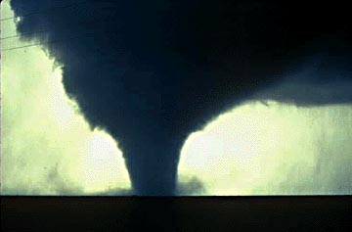
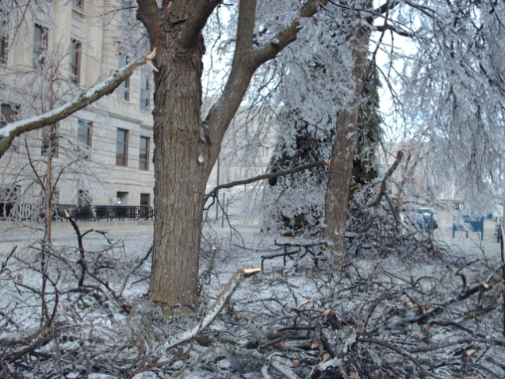
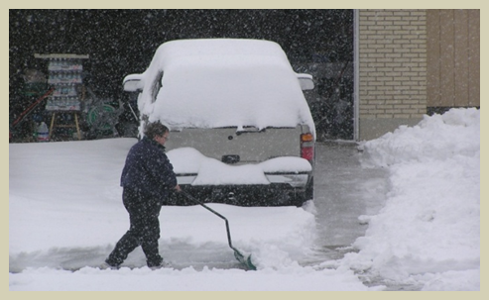
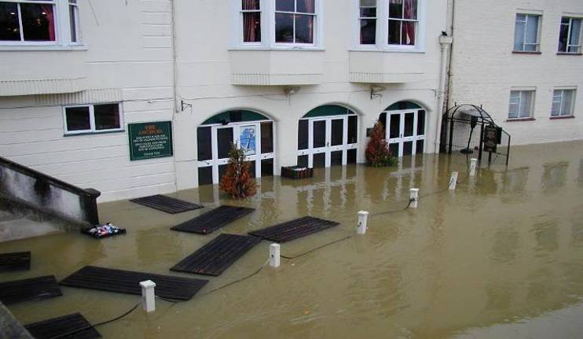
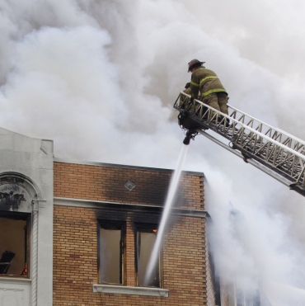
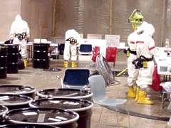
Emergencies Happen
Notes:
Have we prepared for all these situations?
What Emergency Management/Crisis Management/Emergency Response Plans do we have on our Campuses?
How about Continuity of Operations Plans (COOP)?
Emergency Operations Center facility, plans or the EM Team.
NIMS: are we compliant? Working towards being compliant? Have we followed DHS mandates, have we institutionalized the ICS?
Do we have the right persons on our EM team? What is the difference for a University setting compared to the standard ICS positions?
Do we have Mutual Aid Agreements to provide assistance and/or resources? Are we prepared to offer resources to our communities?
How is our Community relations?

Slide 3
"If you don't know where you are going, you are certain to end up somewhere else."
- Yogi Berra
Notes:
The PIO is under the direction of the UML University Relations
How important is it to provide an accurate and informative message?
What are the procedures involved in creating and dispersing a Press Release or public message? ENS?
Should the Sr. Administrative or Cabinet Members approve all messages?

Slide 4




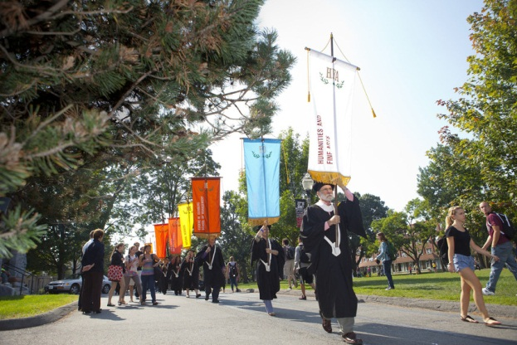
Collaborated Approach

Slide 5
Vision: Create a Disaster Resilient University
Disaster Resilience, as UMass defines it, is the ability to prevent and protect members of the campus community and campus assets against natural or human-caused hazards, to effectively respond to such hazards, and to expeditiously recover and reconstitute educational, research and public services with minimum disruption to the UMass community.
Notes:
The entire University takes a comprehensive approach to emergency planning and business continuity and places the safety and security of its students, faculty, staff and visitors as its highest priority. The goal is create a Disaster Resilient University.
I’m excited to able to share with everyone here today some of the great accomplishments from our campuses EP / BC programs, discuss some of the University’s ongoing activities as well as some opportunities for enhancement as we strive to create Disaster Resilient University.

Slide 6
Emergency Management
Emergency Management creates a framework to help communities/campuses to reduce vulnerabilities to threats and hazards and assists in coping with disasters.
Based on Coordination versus Management.
Integrated into daily decisions.
Involves planning for potential incidents/events.
Protects the University Mission
Notes:
Provides for the coordination and support; not necessarily the management of the incident.
As you’ll see it consists of 5 phases.
Is responsible for the development of plans and procedures prior to an incident or event followed by the implementation of those plans.
EM is not new:
Was first established under the “Congressional Relief Act of 1803, followed by the Disaster Relief Acts of 1950 and then 1969 and 1974 which established the process of Presidential Disaster Declarations and ultimately the Robert T. Stafford Disaster Relief and Emergency Assistance Act in 1988, revised in 2013 and the Disaster Mitigation Act of 2000. They are all based on the premise that disasters are best managed at the lowest possible government level and require an approved mitigation plan to receive disaster assistance funding. Integrates the Governor into the process of requesting federal assistance.

Slide 7
Risk, Business Continuity and Emergency Operations Campus Structure
Policy Group (CLC)
Campus Emergency Risk Management (CERM)
Business Continuity/
Disaster Recovery
Emergency Operations Center (EOC) Team
RISK GROUPS
Student
Faculty/Staff
Reputation
Research
Natural Hazards Disaster Recovery/Business
International Programs
Environmental Health And Safety
Compliance
Develop Response Plans
Determine Essential Functions
Develop Operations Plans
Coordinate Resources
Distribute Situational Reports
Participate in Training and Exercises
Analyze Risks
Develop/Assess Mitigation
Evaluate/Recommend
Monitor and Review
Notes:
This is the overview of the organization structure of Risk and Emergency Management and Business Continuity
The blue side….
The green side …
Finally – I’ll end with CERM’s evolving role…

Slide 8
CEMP Development
CEMP Base Plan
Emergency Support Function Annexes
Emergency Operations Center Procedures
Additional Plans /Annexes
Hazard Mitigation Plan
Emergency Notification System Protocols Annex
Business Continuity Plans
The CEMP Base Plan is comprised of:
  Plan documentation
  Authorities and standards
  Introduction (mission, purpose, scope…)
  Concept of operations (utilization, structure, roles and responsibilities…)
  Organization and assignment of responsibilities (succession of authority…)
  Plan development and maintenance
  Glossary and acronyms

Slide 9
Emergency Support Functions (ESF)
ESF #1- Transportation
ESF #2 – Information Technology
ESF #3 – Facilities & Campus Services
ESF #4 – Fire Services / Hazardous Materials
ESF #5 – Emergency Management
ESF #6 – Housing
ESF #7 – Auxiliary Services
ESF #8 – Finance & Resource Management
ESF #9 – Health Services
ESF #10 – Law Enforcement
ESF #11 – Academics
ESF #12 - Student Affairs
ESF #13 – Research
ESF #14 – Public Information &
External Relations

Slide 10
All-Hazards Approach: Human or Natural
Effective and consistent response to any disaster or emergency, regardless of cause
Risk-based, all hazards strategy based on 5 phases:
  Mitigation
  Prevention
  Preparedness
  Response
  Recovery
Notes:
Success in dealing with disasters depends on how:
Well prepared we are
How organized
And coordinated we are.
These phases outline the steps in preventing, preparing for, responding to and managing the effects of emergencies.

Slide 11
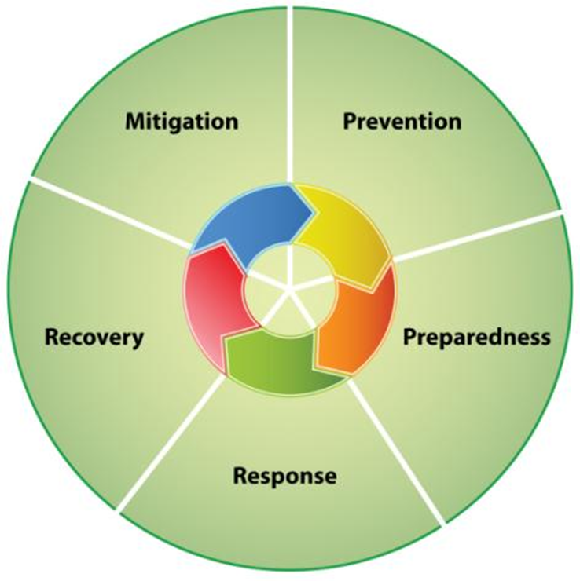
Five Phases of Emergency Management
  Mitigation
  Prevention
  Preparedness
  Response
  Recovery
Notes:
Success in dealing with disasters depends on how:
Well prepared we are
How organized
And coordinated we are.
These phases outline the steps in preventing, preparing for, responding to and managing the effects of emergencies.

Slide 12
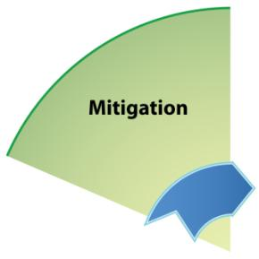
Mitigation Phase
Mitigation is the action colleges and universities take to eliminate or reduce the loss of life and property damage related to an event or crisis, particularly in regard to events or crises that cannot be prevented.
Notes:
Mitigation’s purpose is to reduce or eliminate the potential impact of an occurrence.
Intended to reduce the long term risks on our Campus
What mitigation actions have we untaken at our Universities?
Conduct the Threat and Vulnerability Assessment
Hazardous Materials tracking
Security concerns
Emergency notification
Development of response plans
Clearing storm drains, clearing sidewalks, providing lighting, fire exit drills and fire alarm systems

Slide 13
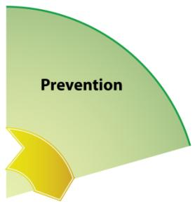
Prevention Phase
Reviews existing campus and community data
Assesses facilities and grounds
Assesses culture and climate issues
Identify our vulnerabilities
Notes:
Basically: Prevention reduces the likelihood of an occurrence.
Prevention is intended to create a deterrent to something occurring.
Prevention is always the best option when possible.
What are some Prevention actions that we take on a continuous basis:
STARS
Police Chief’s Advisory Committee
Code enforcement
Threat and Vulnerability Assessment

Slide 14

Preparedness Phase
Prepares for, and Mitigates the effects of emergencies
Designs strategies, processes, and protocols prior to an emergency
Is a continuous process
Notes:
NIMS Preparedness video: 1:16
Preparedness is defined as the actions taken to plan, organize , equip, train and exercise to build and sustain the capabilities necessary to prevent, protect against, mitigate the effects of, respond to and recover from threats.
It must be done on an ongoing basis to ensure they evolve with the location and changes.
How do we prepare our Campus for emergencies?
Train and exercise
EOP/COOP/BCP, Obtain resources and facilities
Perform Threat, Risk & Vulnerability Assessments
Develop MOUs, MOAs and MAA (Mutual Assistance Agree.)

Slide 15
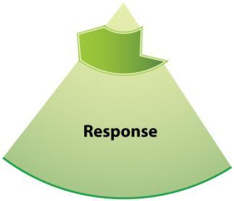
Response Phase
Is the action we take to contain and resolve an emergency effectively
Activates our EOP
Requires informed decision-making and clear lines of authority
Notes:
Fulfills the UML Mission, builds confidence in our University
WHAT WE DO WHEN AN INCIDENT HAPPENS.
Uses the ICS, establish a ICP, and manages public information
May rely on previously developed plans
Requires resources: internal and external (Local, State or Federal resources)
Incidents may be large or small, so we may need outside assistance or only a few trained individuals for a brief time.
May be over in a few minutes or linger for several days.
May need a delegation of authority to perform specific actions.
Will rely on an Incident Action Plan (IAP).

Slide 16
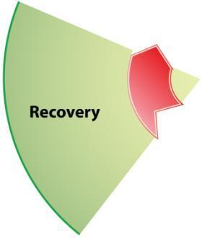
Recovery Phase
Establishes procedures, resources, and policies to return to normal functions
May be a prolonged process
Restores the learning environment
Begins in the Preparedness Phase and requires support from campus leaders
Notes:
Recovery is what we do after the incident is over to return to normal.
Implements our Business Continuity Plan or the
Continuity of Operations Plan (COOP).
Where we conduct critical incident stress debriefings (CISD) and critique our actions
Attempt to recover costs and replace damaged property.
When we attempt to get back to normal.
Builds confidence in our University

Slide 17
Integrated Emergency Management
Emergency Management is integrated into “daily activities”.
Enables outside agencies to work together with UMass Amherst Departments by improving coordination and cooperation among those involved.
IEM addresses all hazards on Campus, is useful in all phases of response and will knit together all participants for a mutual goals.
Notes:
2 aspects of IEM:
Emergency Management needs to be integrated into our daily activities.
Improves interagency coordination, communications and situation awareness
Builds teams.
When we integrate we identifies problems before they are an incident and begins the resolution of the problem.

Slide 18
Lessons Learned from the
Boston Marathon Tragedy

Slide 19
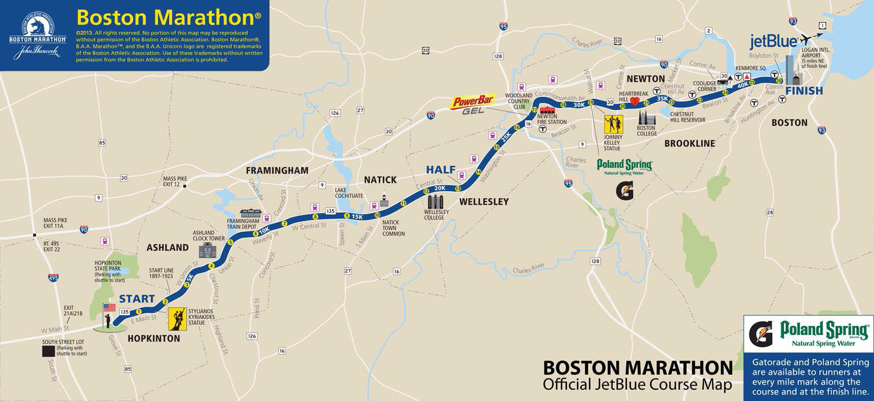
Boston Marathon Route

Slide 20
Marathon by the Numbers
26.2 Miles Long
8 Communities
50 Organizations of Interagency Public Safety
27,000 Official Entrants
1,200 Medical Personnel
1,5000 Security Personnel
8,500+ volunteers
500,000 spectators
26 Medical Stations (8 enhanced)
Finish Area (700 Medical Personnel)
600 Buses
35,000 Gallons of Water
$80 Million generated to local economy
180 Media Outlets representing 15 countries
Telecast to more than 200 countries

Slide 21
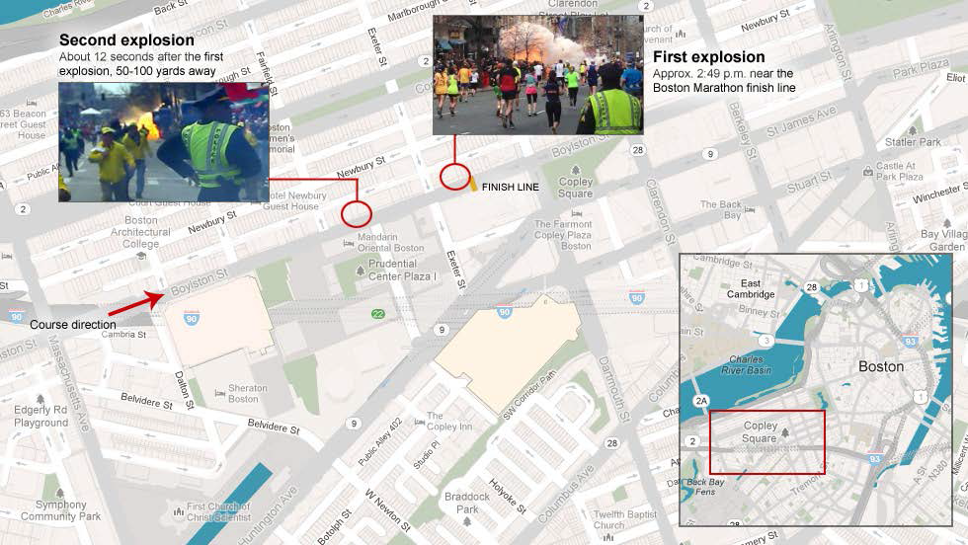
2:50PM - Monday, April 15, 2013 –
The Explosions

Slide 22
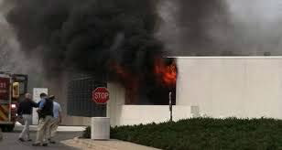
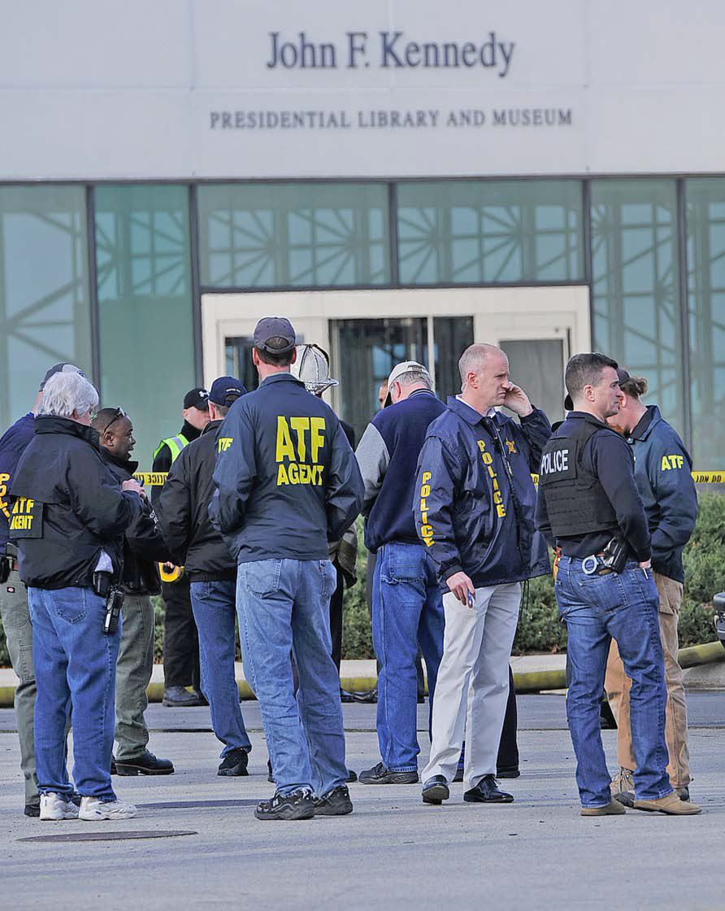
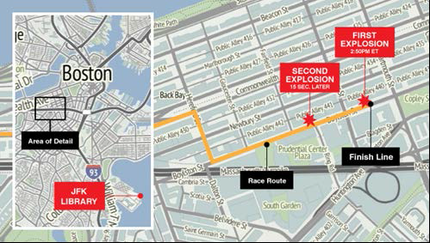
Fire at JFK Library

Slide 23
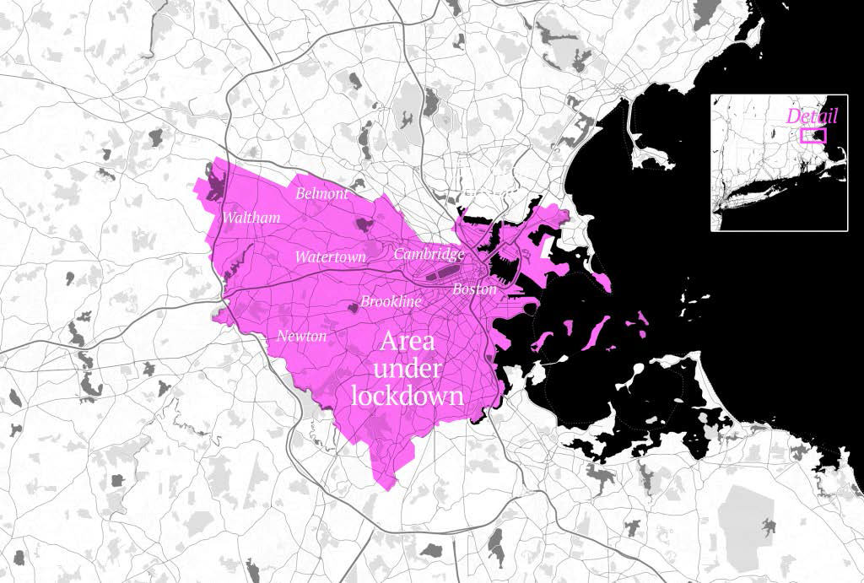
Shelter-in-Place
Nearly 1,000,000 people Sheltering-in-Place and no Mass Transit in Boston Metro area all businesses shut down

Slide 24
Friday, April 19th
7:10 am. -- UMass Dartmouth Public Safety developed information that suspect in the Boston Marathon bombing, is registered as a student at UMass Dartmouth.
8:13 a.m. – Pine Dale Residence Hall evacuated.
8:47 a.m. – Campus closed via MyAlert system and community members asked to shelter in place.
10:02 a.m. – Second MyAlert issued. Controlled campus evacuation of approximately 7,500 students, faculty and staff ordered. Students with no immediate transportation or place to go staged at Parking Lot 1 to await transport to Dartmouth High School.

Slide 25
Friday, April 19th
10:30 a.m. – Text-only web site launched to handle heavy incoming traffic.
1 p.m. – Evacuation 7,500 students, faculty, and staff of campus completed in safe and orderly fashion.
3:45 p.m. – All students staged at Dartmouth High School picked up or transported to nearby hotel.
7:53 p.m. – Suspect apprehended in Watertown, MA

Slide 26
Key Points
Three Command Centers Established
  Policy Group
  Operations
  Command Post
Data Requests
Interviews
Continued Investigation
Logistics
  Hotel Accommodations
  Dining Services
  Transportation

Slide 27
Next Few Days
Saturday 4/20/13
  Campus remains closed to accommodate ongoing investigation
Sunday 4/21/13
  Campus opens at 9 a.m. and residence halls at 12:00 p.m. following completion of evidence recovery by FBI
  Campus hosts ice cream social
Monday 4/22/13
  Student Vigil
Wednesday 4/24/13
  UMass Dartmouth Community BBQ

Slide 28

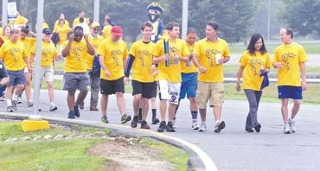
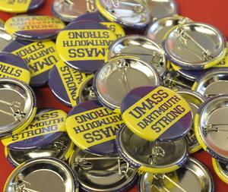
Campus Comes Together

Slide 29

Emergency Preparedness
Everyone should take three preparedness steps:
  Get a Kit
  Make a Plan
  Be Informed
Notes:
Emergency preparedness is a personal and shared responsibility at home, at UMass and within our communities. The best practice from federal, state, local, and institutions of Higher education is to take the following steps…Get a Kit, Make a Plan and Be Informed
Show Video.
When I showed my wife this video her first reaction I think the video is all wrong. I said really you do not think get a kit, make a plan and be informed is well described in the video, she said oh no I thought that was great. Did you not think the tornado look real, she no that looked real.
Then I said what is wrong with the video. My wife said…there is no way you would be sitting on chair reading the newspaper while I am doing all the yard work. Then I said like emergency preparedness being a shared responsibility so is yard work.
Now what the video doesn’t show is me having to sleep on the chair that night.

Slide 30
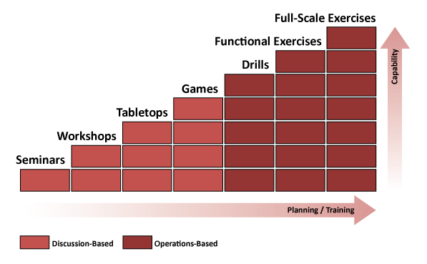
Training and Exercises
Reinforces a culture of preparedness on campus through facilitated discussions and hands-on exercises testing existing plans and procedures
Identifies areas for sustainability and improvement in departmental and university-wide plans, protocol, and procedures
Facilitates the right exercise for department/university needs.
Quarterly EOC Meetings will always include training and exercise
ICS / NIMS Training

Slide 31
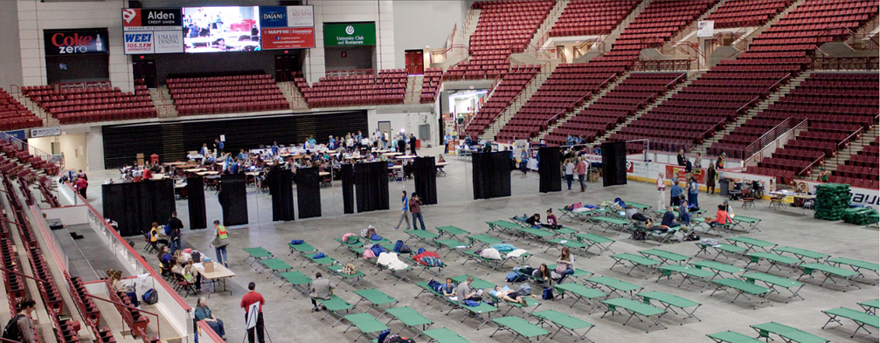
Full-Scale Shelter Exercise at Mullins Center (April 2014)

Slide 32
Emergency Notification Messages
Sign up for UMass Alerts – Emergency Text Messaging
  www.umass.edu/emergency
Outdoor Sirens
Emergency E-mails
UMass Homepage
UMass Social Media (Facebook & Twitter)

Slide 33

Questions?

Slide 34
THANK YOU!

Slide 35
  Contact Information
  Jeffrey Hescock
  Director of University Emergency Management and Business Continuity
  413-545-7431
  jhescock@ehs.umass.edu

